Slide 1
XinCheJian SwarmRobot Group
a brief history

Slide 2
XinCheJian SwarmRobot Group
Started in Late April

Slide 3
XinCheJian SwarmRobot Group
Started in Late April
  Kick off meeting

Slide 4
XinCheJian SwarmRobot Group
Started in Late April
  Kick off meeting
  Developed heaps of ideas
  ShoppingCentre display - SoccerBot proposal
    HEAPS more ideas

Slide 5
XinCheJian SwarmRobot Group
Started in Late April
  Kick off meeting
  Developed heaps of ideas
  ShoppingCentre display - SoccerBot proposal
    HEAPS more ideas
    Agency did not fund

Slide 6
XinCheJian SwarmRobot Group
Started in Late April
  Kick off meeting
  Developed heaps of ideas
  ShoppingCentre display - SoccerBot proposal
    HEAPS more ideas
    Agency did not fund
  Created prototypes

Slide 7
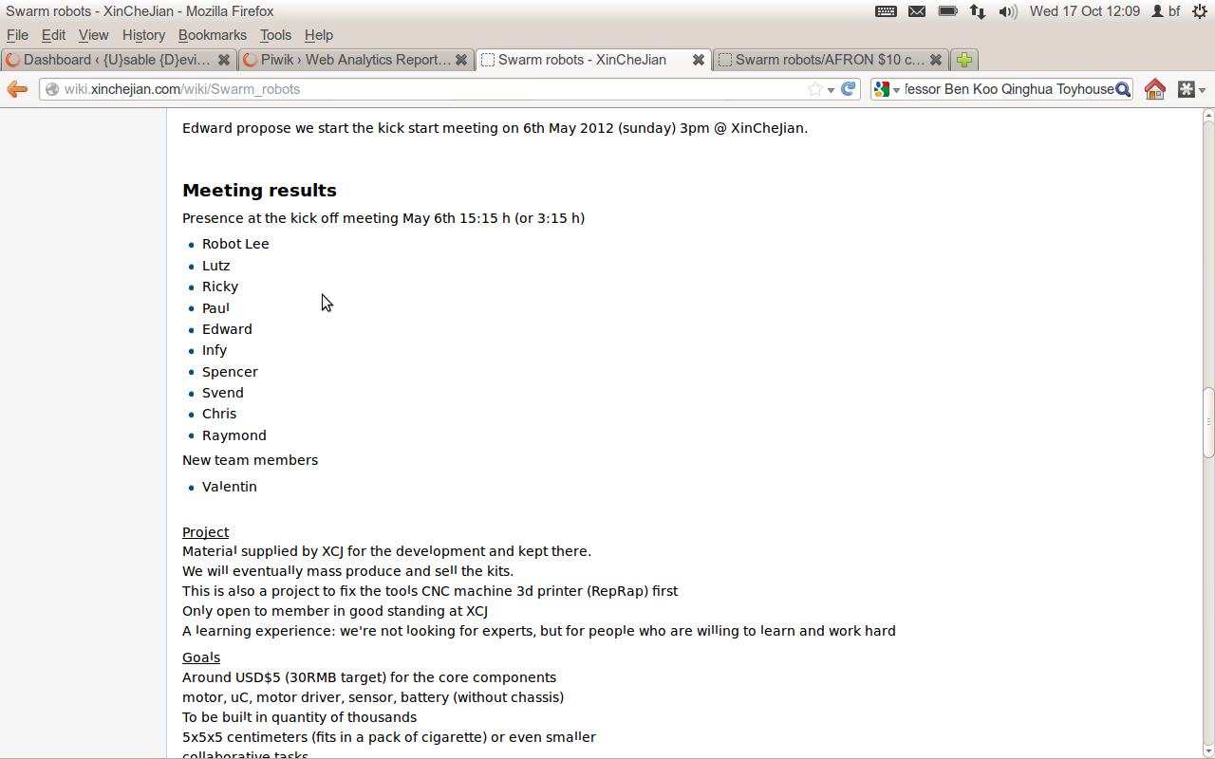
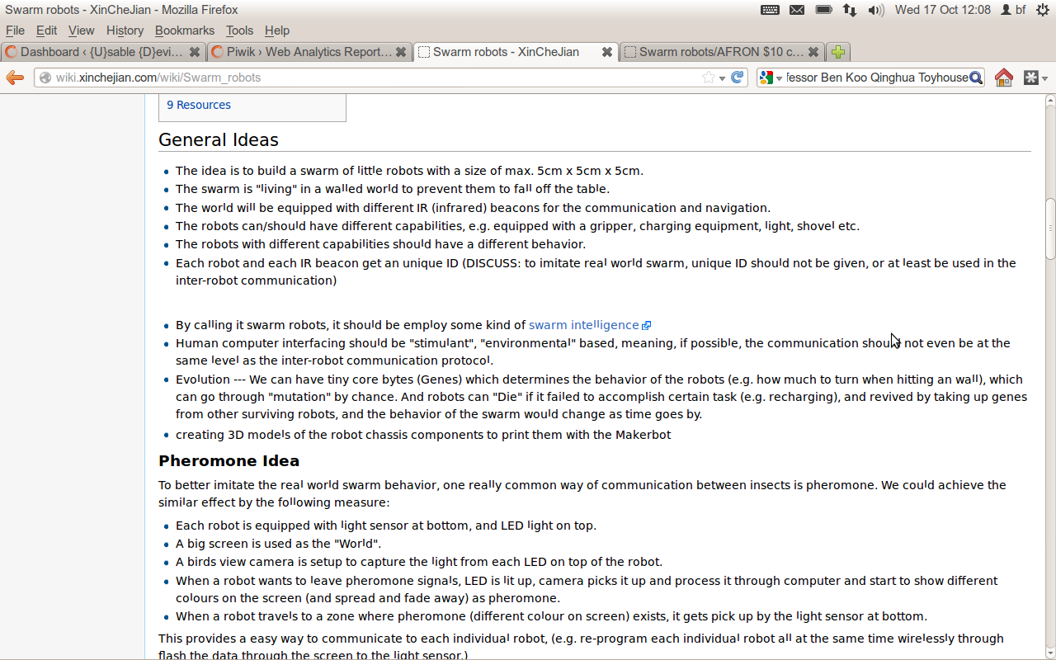
XinCheJian SwarmRobot Group

Slide 8
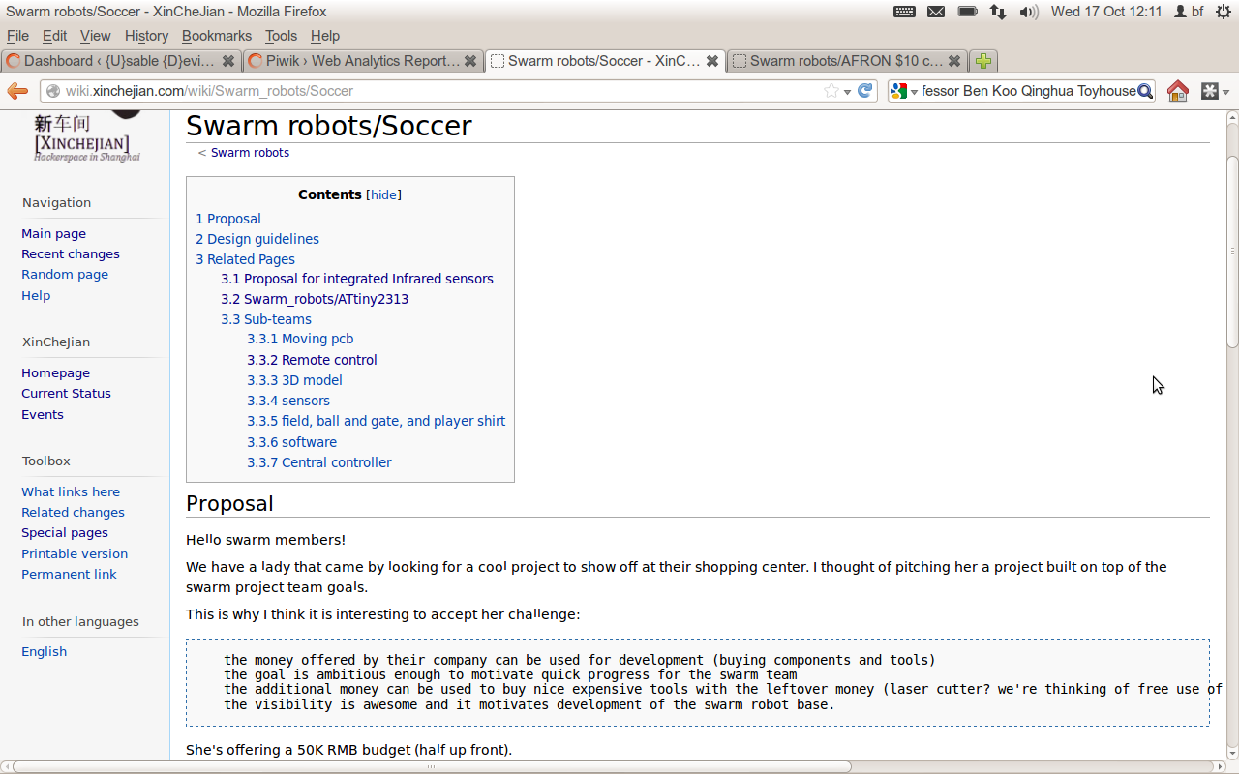
XinCheJian SwarmRobot Group

Slide 9
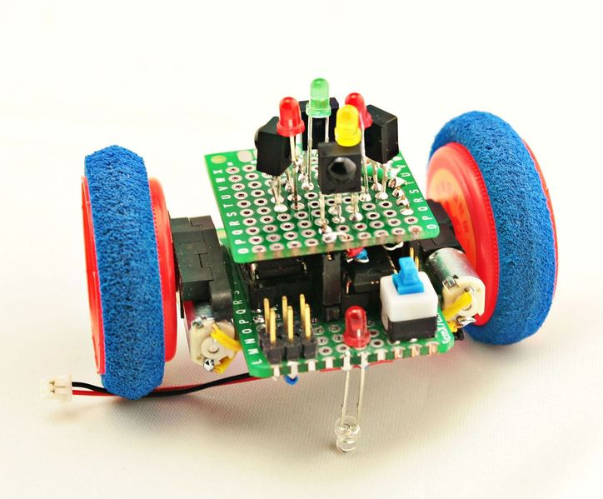
XinCheJian SwarmRobot Group

Slide 10
XinCheJian SwarmRobot Group
More side tracks
  some members overseas
  others sidetracked on many other projects
  Running the new space (here!)
  events (Beijing & Shenzhen Maker Carnivals, Childrens Day, Barcamp, ...)

Slide 11
XinCheJian SwarmRobot Group
More side tracks
  some members overseas
  others sidetracked on many other projects
  Running the new space (here!)
  events (Beijing & Shenzhen Maker Carnivals, Childrens Day, Barcamp, ...)
July made printed circuit board

Slide 12
XinCheJian SwarmRobot Group
More side tracks
  some members overseas
  others sidetracked on many other projects
  Running the new space (here!)
  events (Beijing & Shenzhen Maker Carnivals, Childrens Day, Barcamp, ...)
July made printed circuit board
Prototypes: IR follower & wall avoid

Slide 13

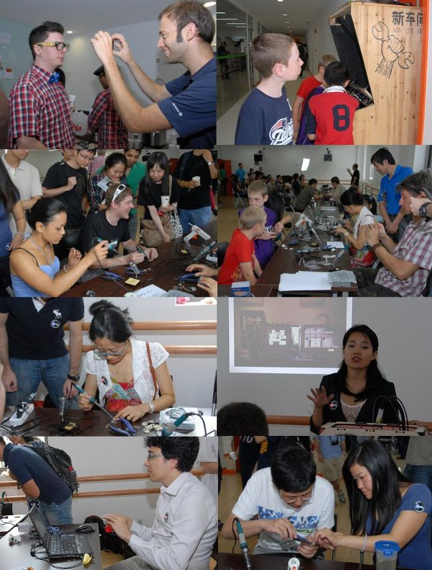
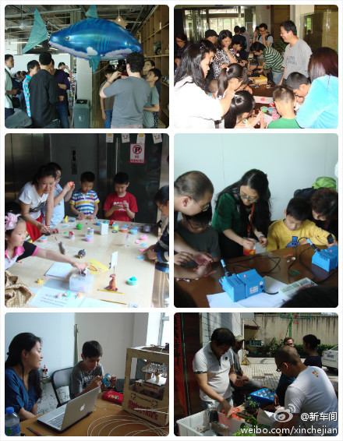
XinCheJian SwarmRobot Group

Slide 14
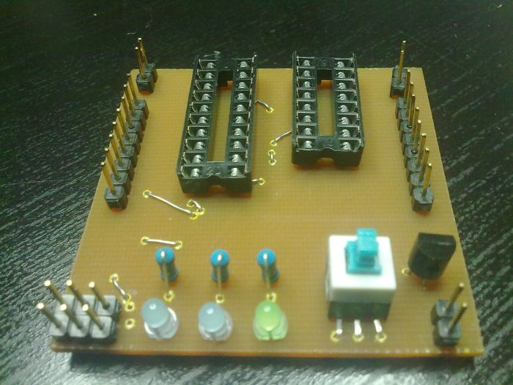
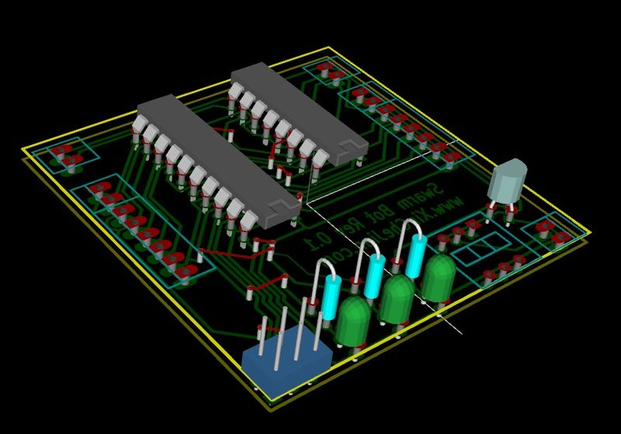
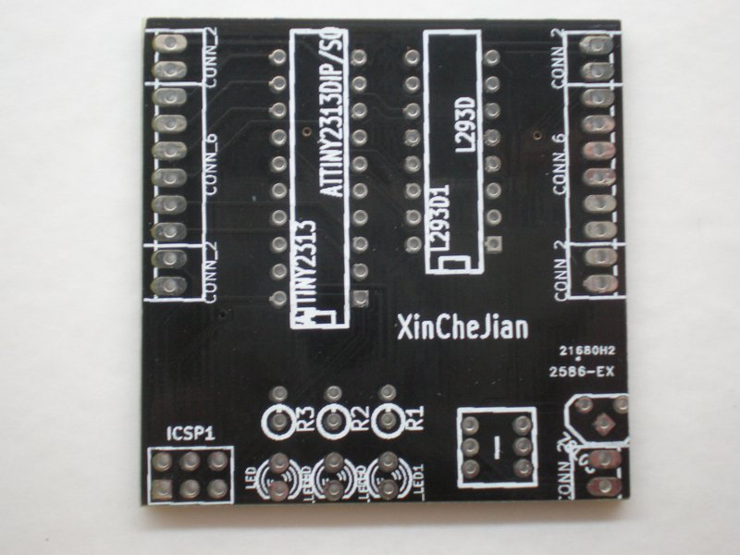
XinCheJian SwarmRobot Group

Slide 15
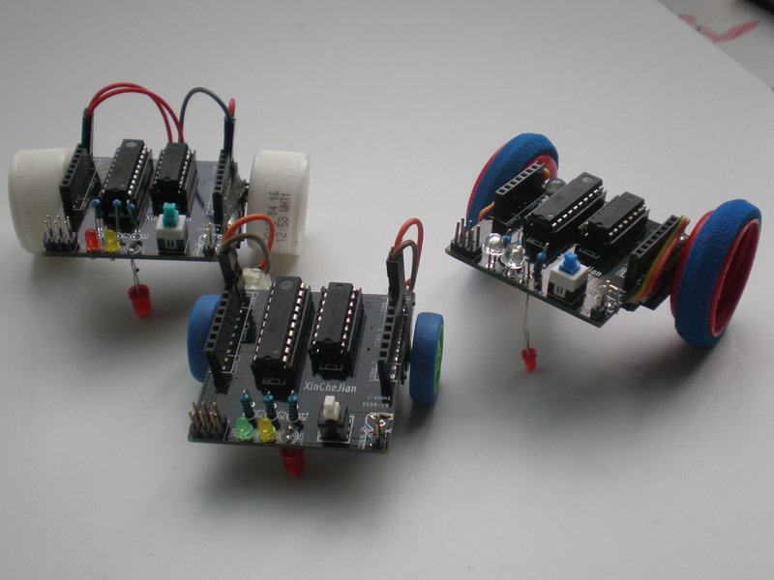
XinCheJian SwarmRobot Group

Slide 16
XinCheJian SwarmRobot Group
Video IR follower

Slide 17
XinCheJian SwarmRobot Group
Video switch wall avoid

Slide 18
XinCheJian SwarmRobot Group
Others branching out more ideas
  Experiments
  Arduino versions

Slide 19
XinCheJian SwarmRobot Group
Others branching out more ideas
  Experiments
  Arduino versions
Made IR shield PCB

Slide 20
XinCheJian SwarmRobot Group
Others branching out more ideas
  Experiments
  Arduino versions
Made IR shield PCB
PCB delivered just before workshop

Slide 21
XinCheJian SwarmRobot Group
Others branching out more ideas
  Experiments
  Arduino versions
Made IR shield PCB
PCB delivered just before workshop
Workshop same day as competition entry due.

Slide 22
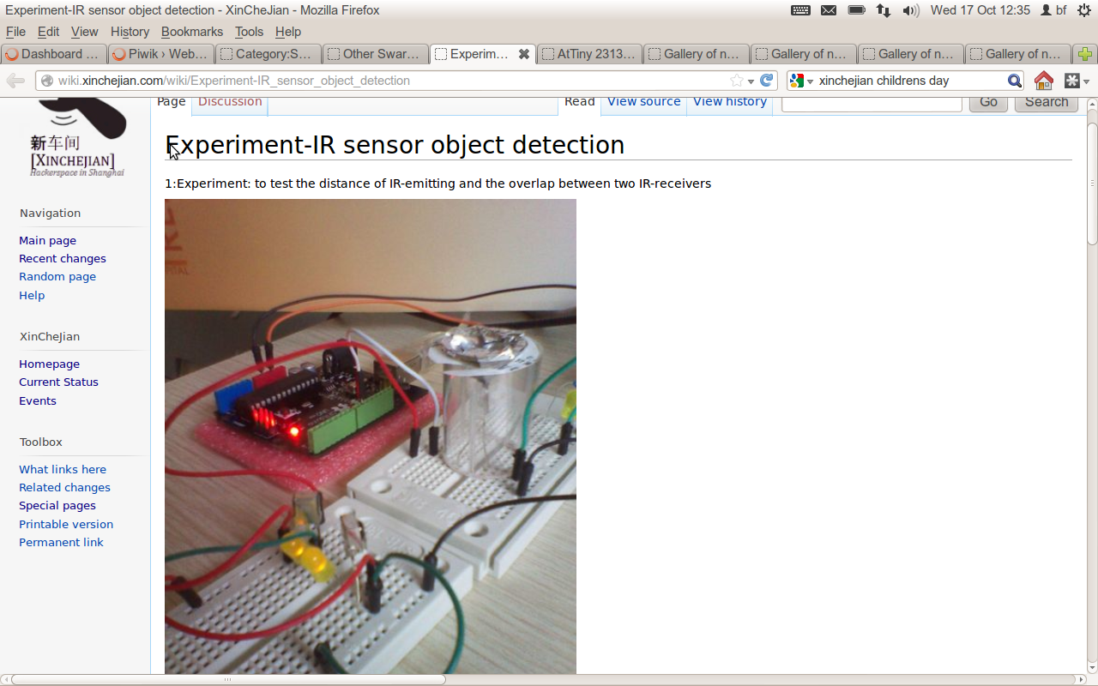
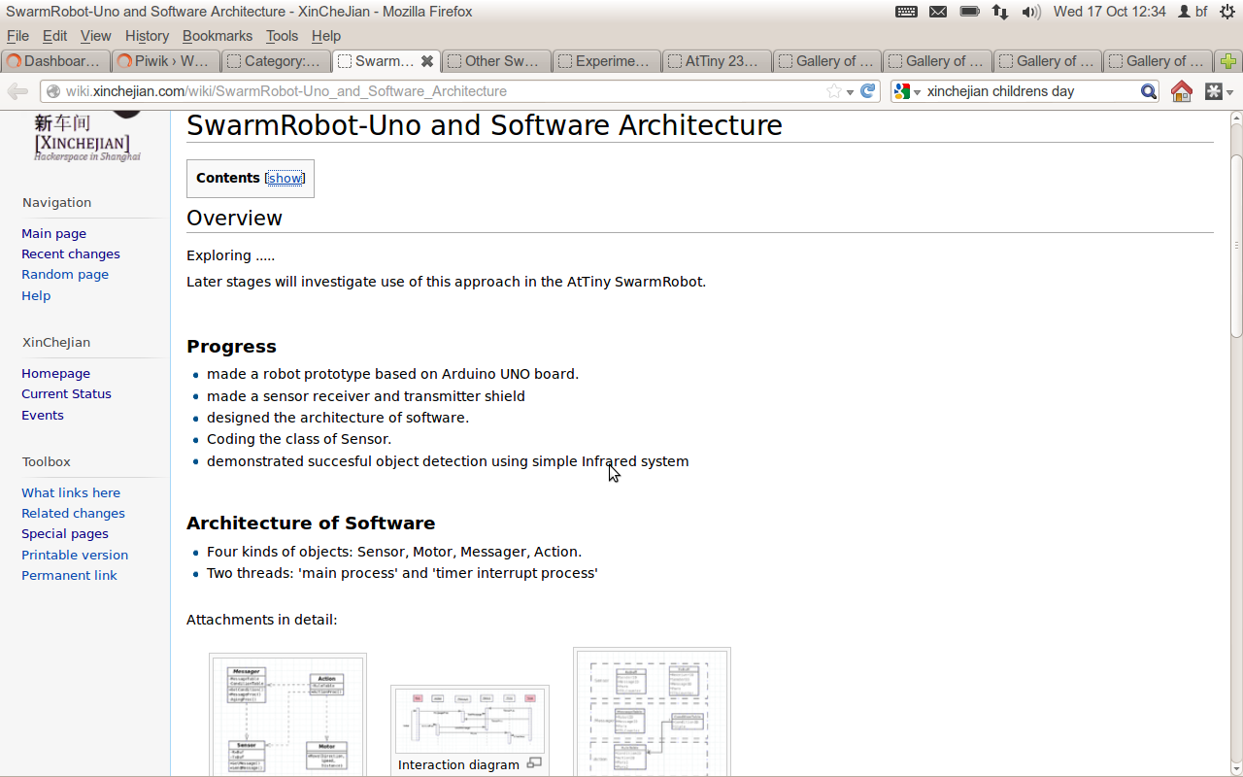
XinCheJian SwarmRobot Group

Slide 23
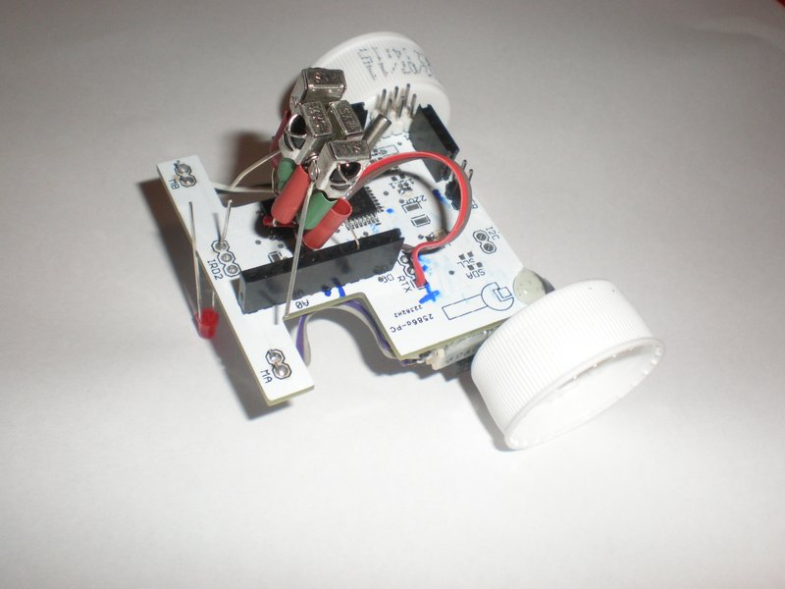
XinCheJian SwarmRobot Group

Slide 24
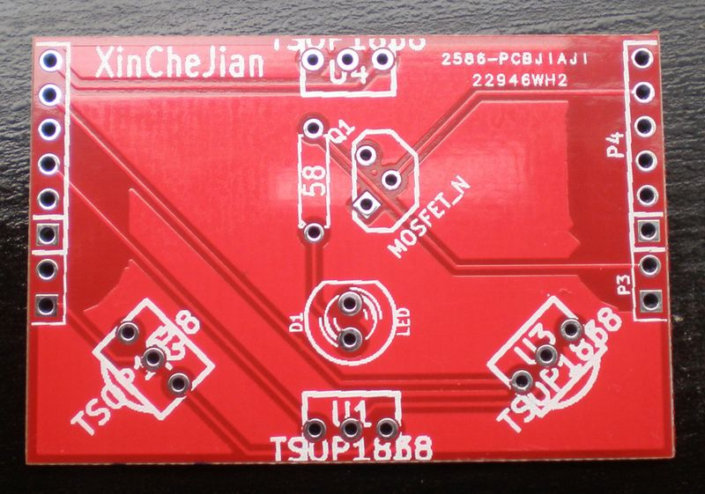
XinCheJian SwarmRobot Group

Slide 25
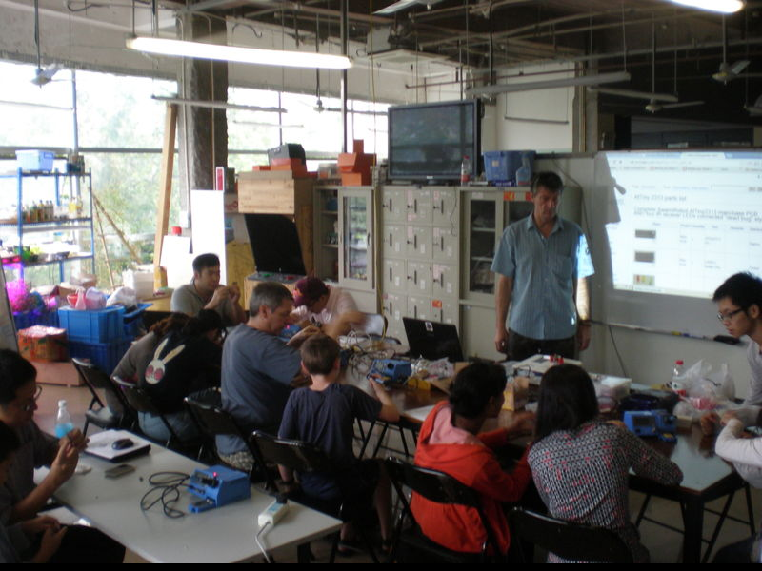
XinCheJian SwarmRobot Group

Slide 26
XinCheJian SwarmRobot Group
Acheivements

Slide 27
XinCheJian SwarmRobot Group
Acheivements
  Second place – behind Harvard but ahead of MIT!

Slide 28
XinCheJian SwarmRobot Group
Acheivements
  Second place – behind Harvard but ahead of MIT!
  Announced at World Maker Fair NewYork

Slide 29
XinCheJian SwarmRobot Group
Acheivements
  Second place – behind Harvard but ahead of MIT!
  Announced at World Maker Fair NewYork
  Three categories, 28 entries

Slide 30
XinCheJian SwarmRobot Group
Acheivements
  Second place – behind Harvard but ahead of MIT!
  Announced at World Maker Fair NewYork
  Three categories, 28 entries
  Stories on Wired and Slashdot

Slide 31
XinCheJian SwarmRobot Group
Acheivements
  Second place – behind Harvard but ahead of MIT!
  Announced at World Maker Fair NewYork
  Three categories, 28 entries
  Stories on Wired and Slashdot
  Wiki page 1700 views

Slide 32

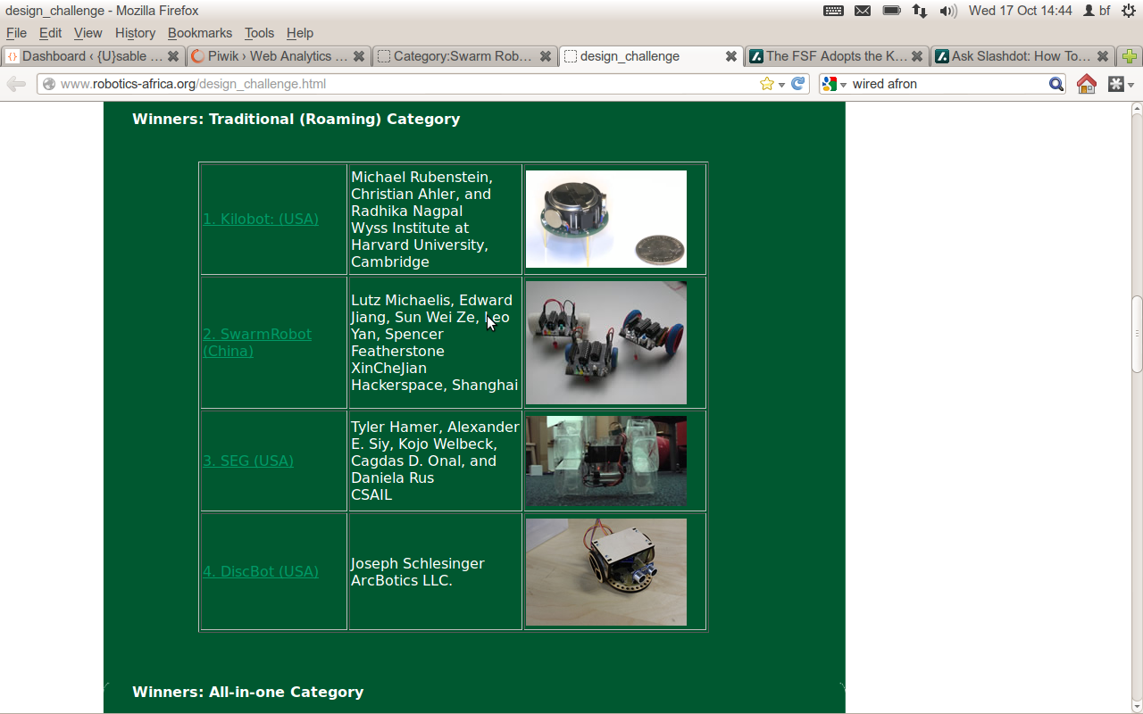
XinCheJian SwarmRobot Group

Slide 33
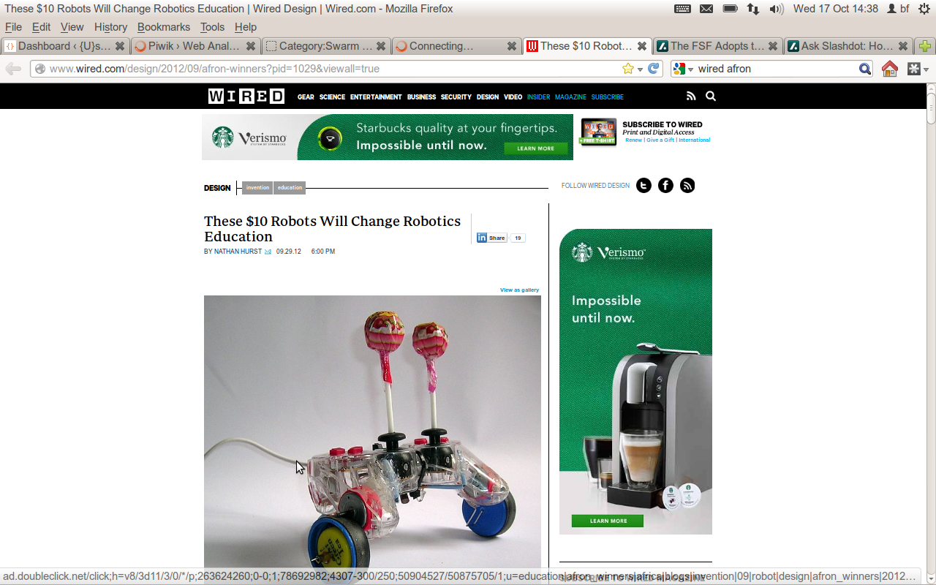
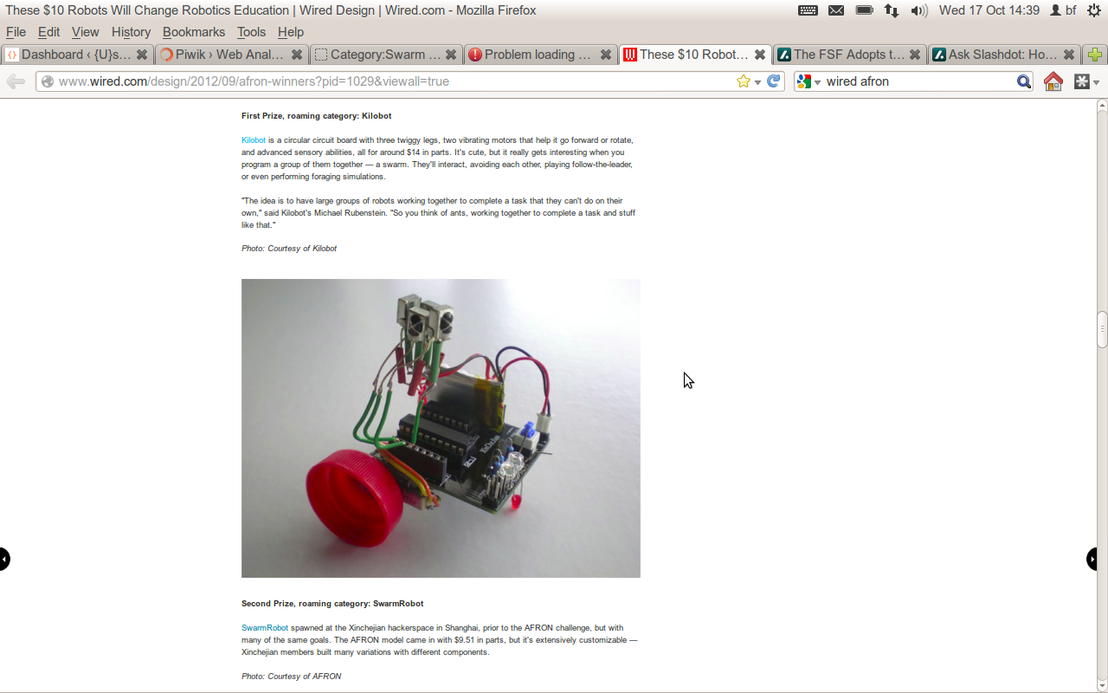
XinCheJian SwarmRobot Group

Slide 34
XinCheJian SwarmRobot Group
Been approached for:

Slide 35
XinCheJian SwarmRobot Group
Been approached for:
  ShoppingCentre display - SoccerBot

Slide 36
XinCheJian SwarmRobot Group
Been approached for:
  ShoppingCentre display - SoccerBot
  Email interview by Journalist - articles for
    Popular Mechanics, IEEE

Slide 37
XinCheJian SwarmRobot Group
Been approached for:
  ShoppingCentre display - SoccerBot
  Email interview by Journalist - articles for
    Popular Mechanics, IEEE
  UC Berkeley Museum display

Slide 38
XinCheJian SwarmRobot Group
Been approached for:
  ShoppingCentre display - SoccerBot
  Email interview by Journalist - articles for
    Popular Mechanics, IEEE
  UC Berkeley Museum display
  Run workshop for 40 students in Shanghai

Slide 39
XinCheJian SwarmRobot Group
Been approached for:
  ShoppingCentre display - SoccerBot
  Email interview by Journalist - articles for
    Popular Mechanics, IEEE
  UC Berkeley Museum display
  Run workshop for 40 students in Shanghai
  Run workshop for 400 students in Shehnzhen

Slide 40
XinCheJian SwarmRobot Group
Been approached for:
  ShoppingCentre display - SoccerBot
  Email interview by Journalist - articles for
    Popular Mechanics, IEEE
  UC Berkeley Museum display
  Run workshop for 40 students in Shanghai
  Run workshop for 400 students in Shehnzhen
  Help deliver to many schools in Beijing

Slide 41
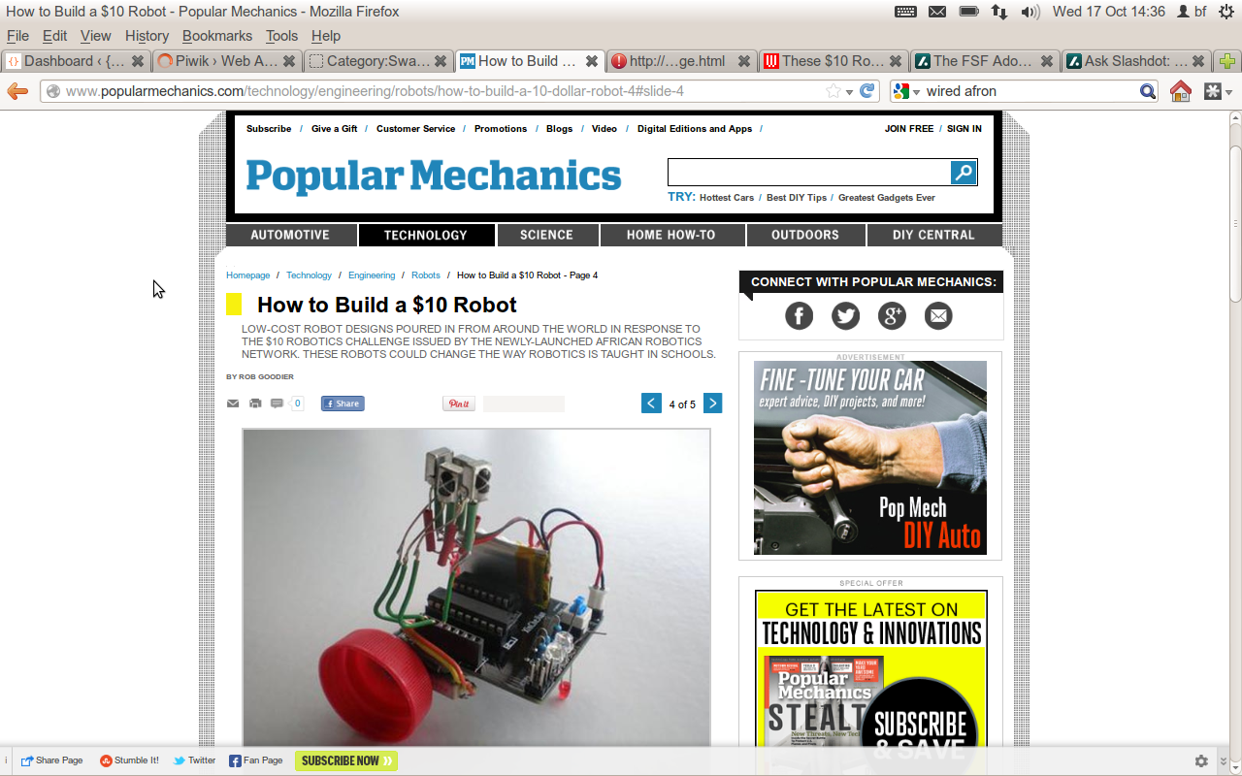
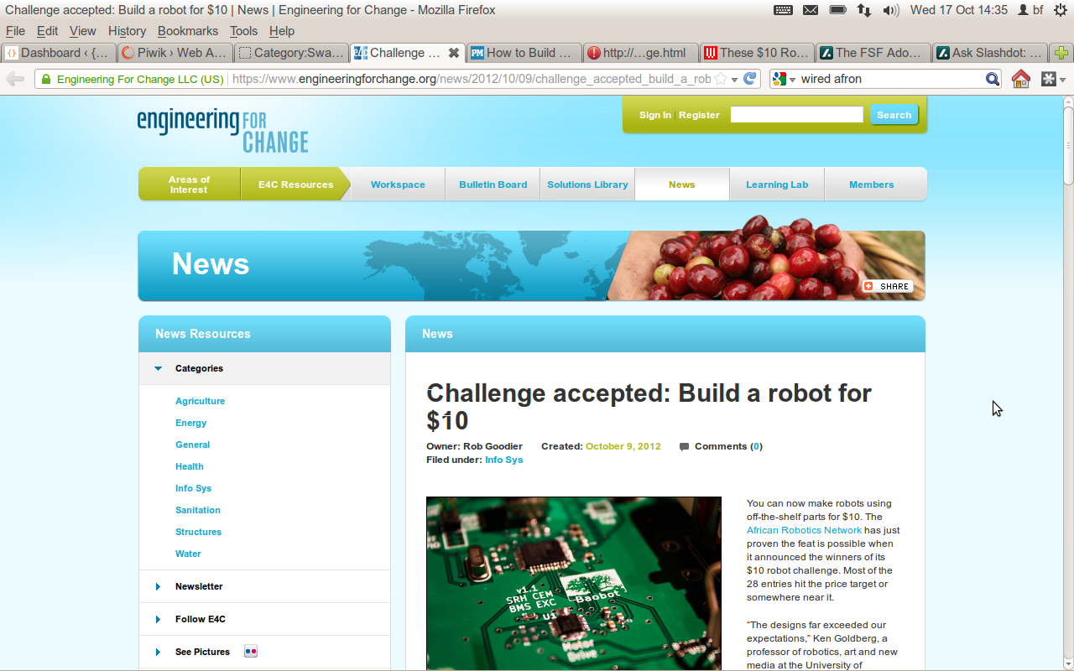
XinCheJian SwarmRobot Group

Slide 42

XinCheJian SwarmRobot Group

Slide 43
XinCheJian SwarmRobot Group
Upcoming:
  Workshop - Saturday 27th Y280 - reserve your place (Y300 at the door)!
  Maker carnival Shanghai November 2-4 expecting over 150,000 visitors

Slide 44
XinCheJian SwarmRobot Group
Upcoming:
  Workshop - Saturday 27th Y280 - reserve your place (Y300 at the door)!
  Maker carnival Shanghai November 2-4 expecting over 150,000 visitors
More hardware, coding and FUN!

Slide 45
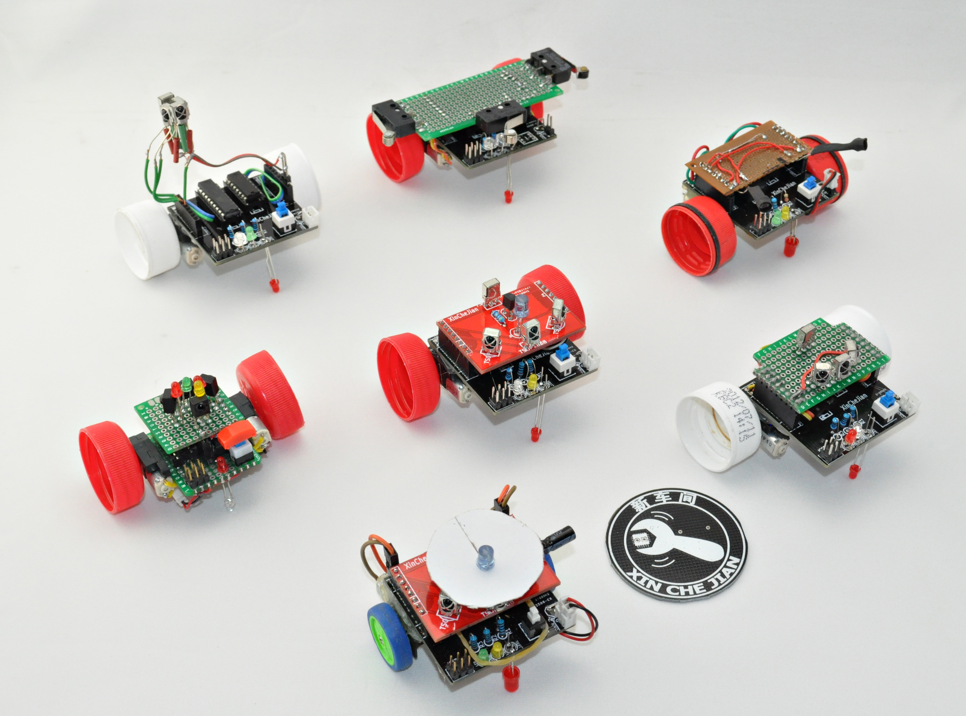
XinCheJian SwarmRobot Group

Slide 46
XinCheJian SwarmRobot Group

